Slide 1



Amazon Data Analysis
View in Power BI
Last data refresh:
5/29/2021 12:16:27 AM UTC
Downloaded at:
6/2/2021 3:06:11 PM UTC

Slide 2
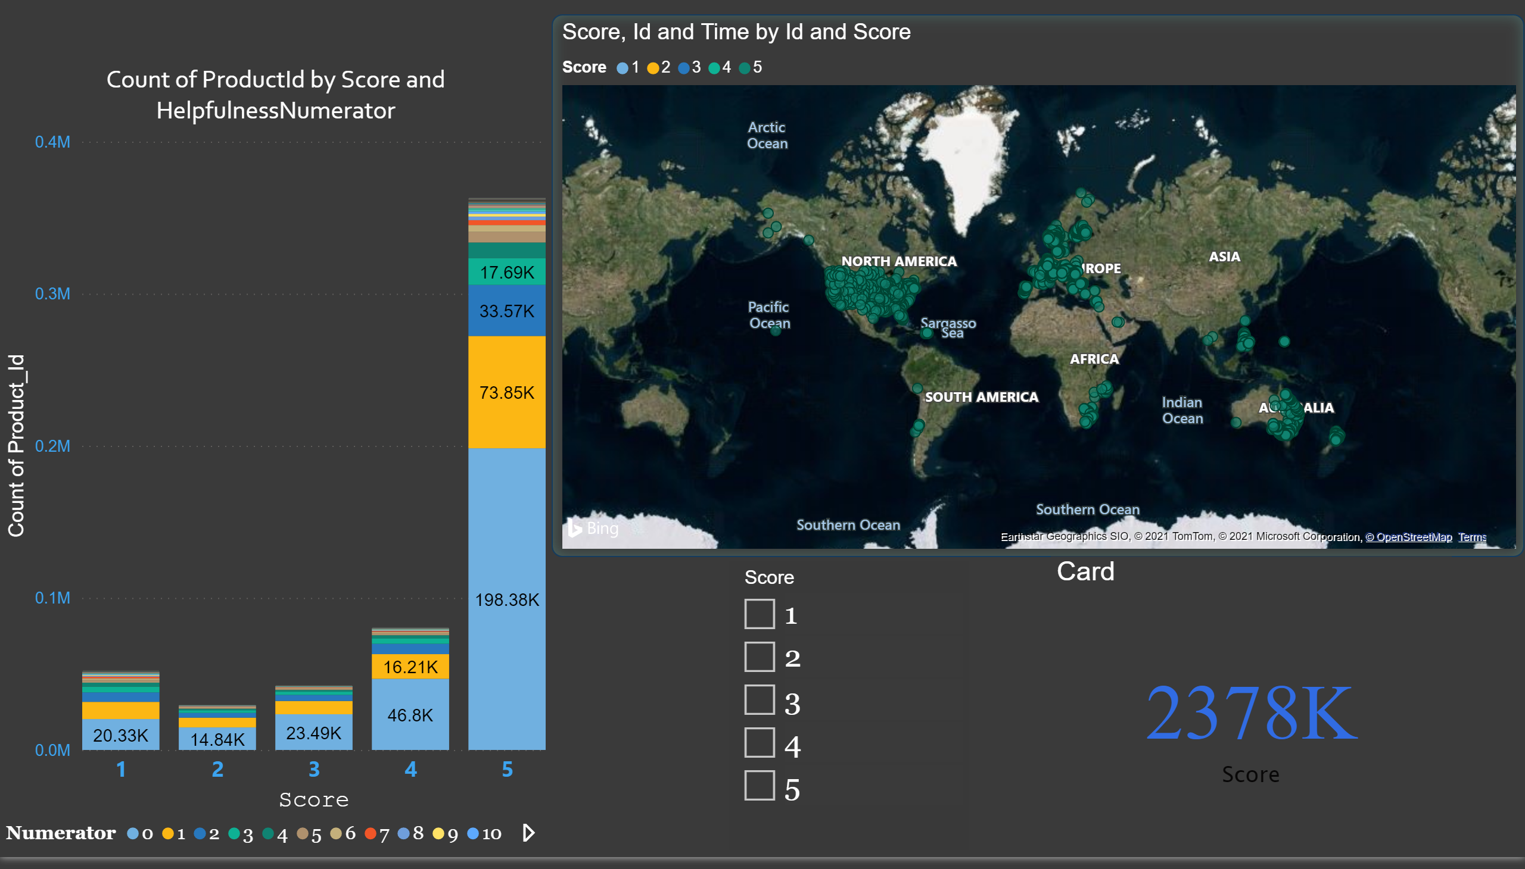
Page 1
Notes:
map
No alt text provided.
columnChart
No alt text provided.
slicer
score
Card
No alt text provided.

Slide 3
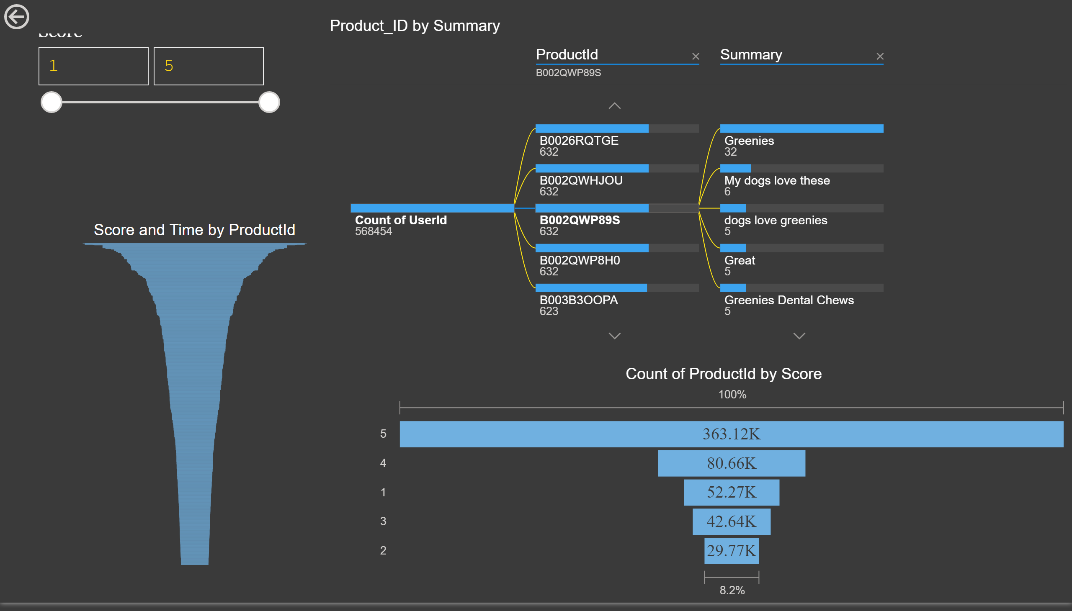
Page 2
Notes:
funnel
No alt text provided.
slicer
No alt text provided.
funnel
No alt text provided.
actionButton
No alt text provided.
Product_ID by Summary
No alt text provided.

Slide 4
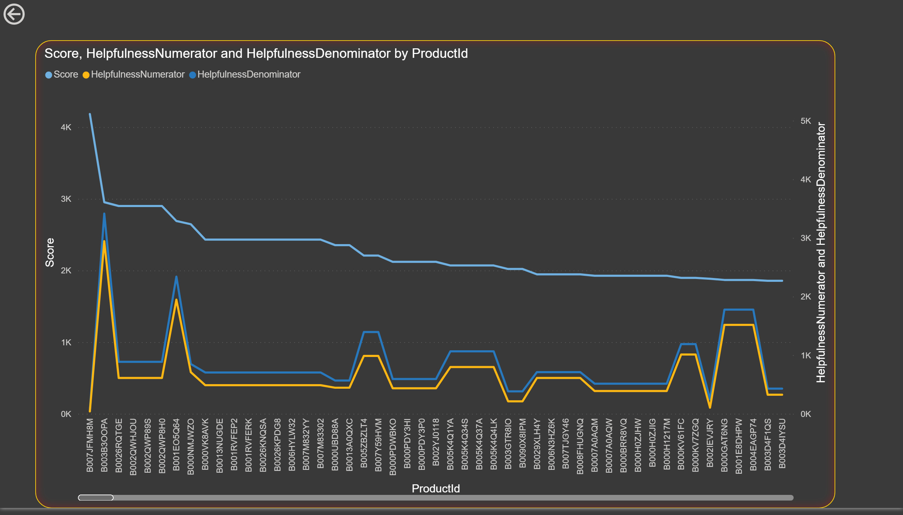
Page 3
Notes:
actionButton
No alt text provided.
lineChart
No alt text provided.

Slide 5
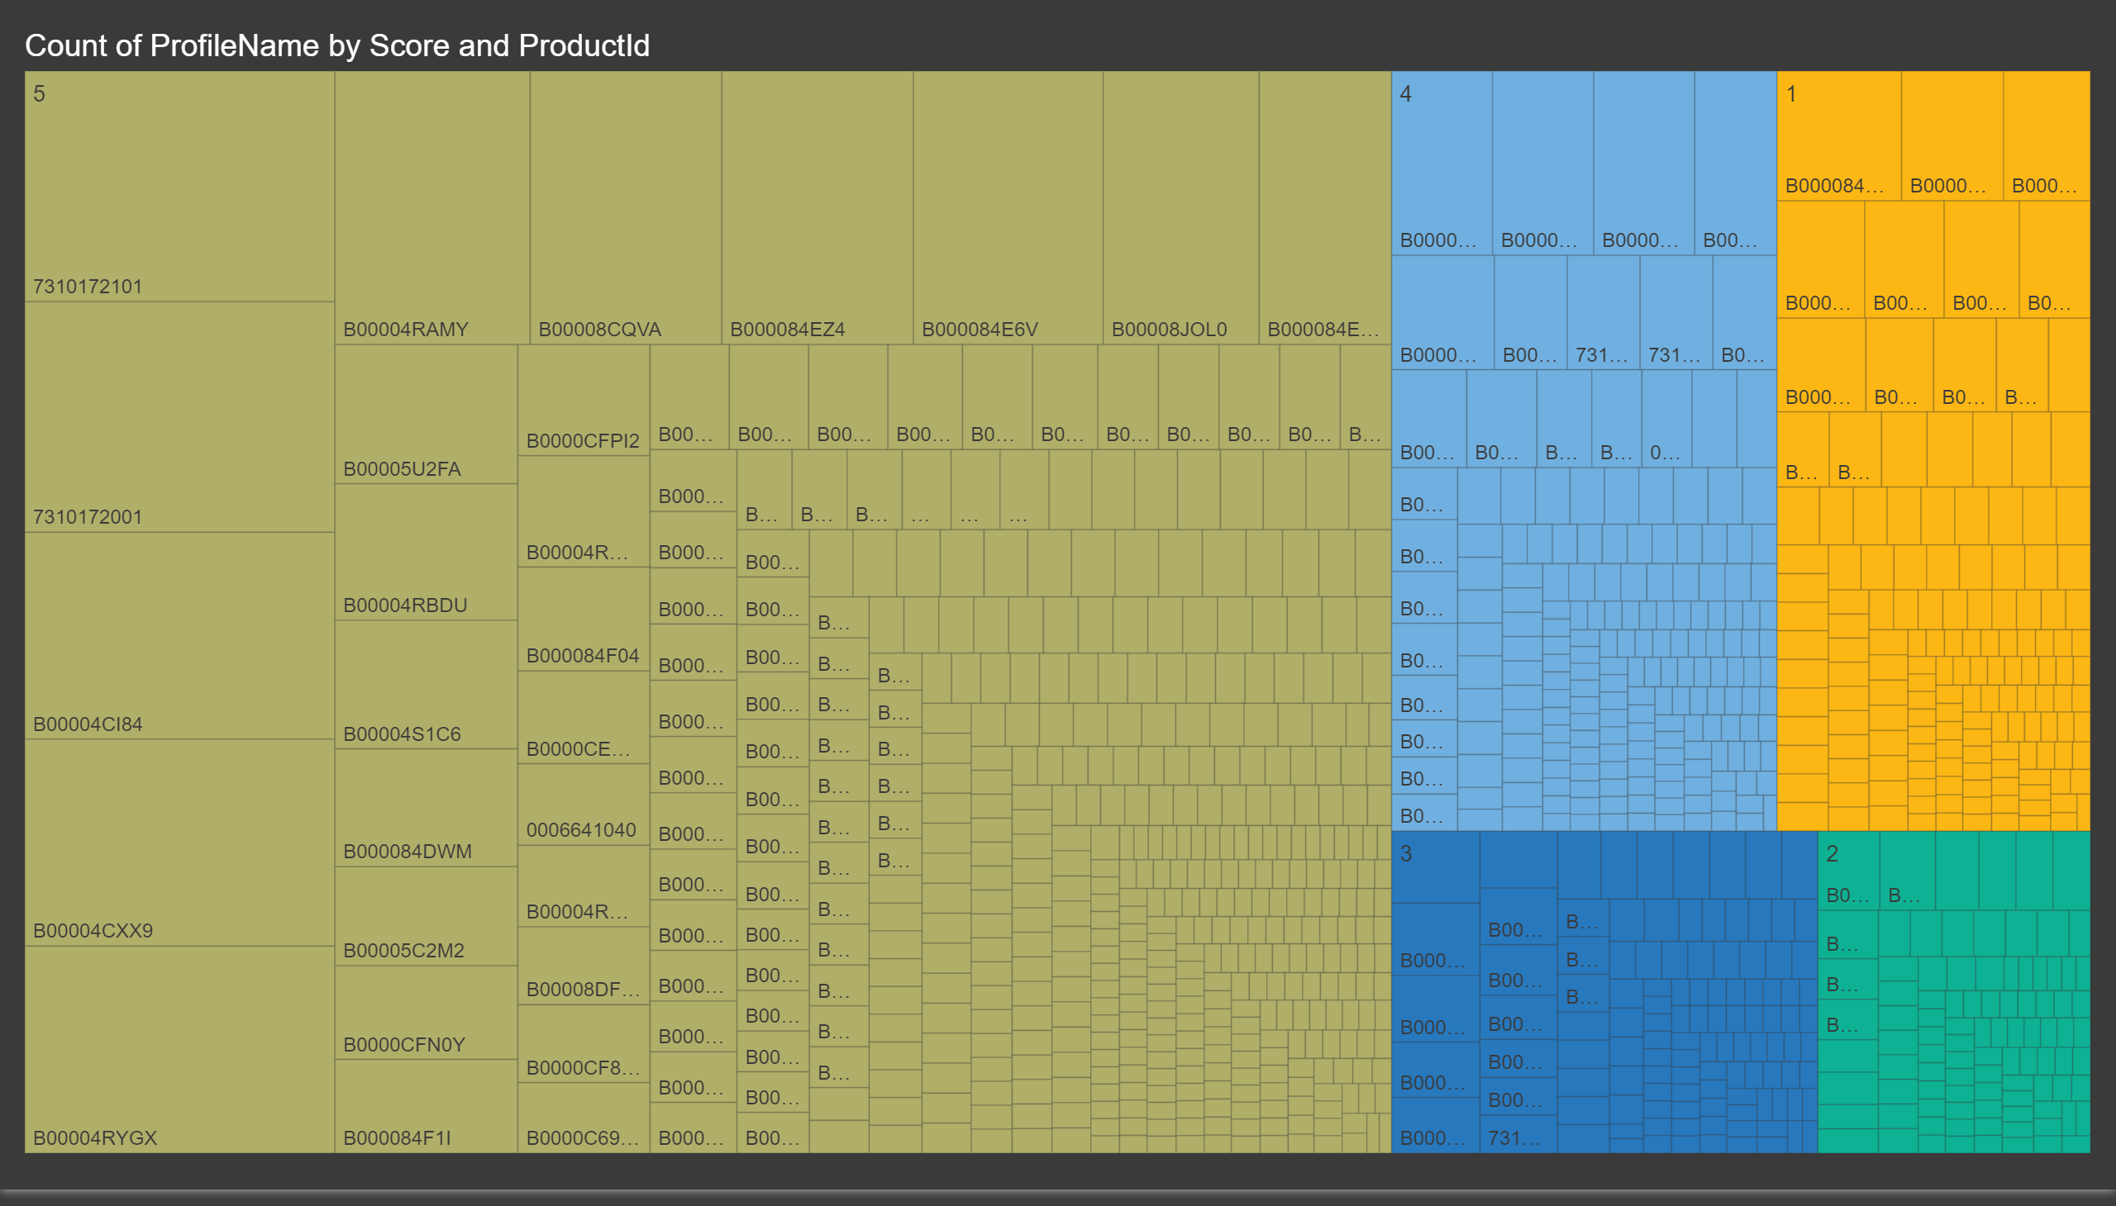
Page 4
Notes:
treemap
No alt text provided.

